Slide 1
Music to Fitness: A Smart Hardware Device for Adaptive Workout Motivation
CSE7101- Capstone Project
Review-5
Batch Number: Com_11
Roll Number | Student Name
20221COM0137 | Abhishek Gowda
20221COM0162 | Rithin U Reddy
20221COM0187 | Rukmini Surve M
Under the Supervision of,
Prof. Mr Mohamed Shakir
Assistant Professor
School of Computer Science and Engineering
Presidency University
Name of the Program: COM
Name of the HoD: Dr Pallavi R
Name of the Program Project Coordinator: Mr. Muthuraj V
Name of the School Project Coordinators: Dr. Sampath A K , Dr. Geetha A

Slide 2
Contents:
Introduction and Problem Statement
Objectives
Work flow
Pseudo Code
100 % Implementation with Live Demo
Final Report Status
Plagiarism Report
Research Paper
SDG Mapping with problem statement
Github Repository
Time line of the Project
References

Slide 3
Introduction and Problem Statement
• Aim: To develop a hardware prototype that adapts music based on real-time heart-rate readings.
• Goal: Enhance motivation during workouts and improve focus during study by automatically adjusting music type according to the user’s BPM.
• Hardware used: ESP32 development board, MAX30102 heart-rate sensor, 0.96″ OLED display, DFPlayer Mini MP3 module, microSD card, 8Ω 1W speaker, breadboards, jumper wires, resistors, capacitors, push buttons (optional).
• Expected outcome: Real-time personalised music response to physiological data (heart rate).

Slide 4
Objectives
Design a low-cost hardware device (ESP32 + HR sensor).
Monitor real-time heart rate during workout/study sessions.
Dynamically adjust music volume, tempo, and playlist according to HR zones.
Provide motivation in sports & fitness through biofeedback + music.

Slide 5
Work Flow:
Measure accurate heart-rate data using the MAX30102 sensor.
Process BPM values on ESP32 and classify them into calm, normal, and high-intensity zones.
Store pre-selected music tracks on a microSD card using DFPlayer Mini.
Automatically play the appropriate music type based on the user’s heart-rate zone.
Display live BPM and system status on a 0.96″ OLED screen.
Build a portable, low-cost fitness-assistive hardware prototype.

Slide 6
Pseudo-code:
START
Setup sensors, OLED, DFPlayer
WHILE true:
Read HR
Show HR on OLED
IF HR < 80 → play calm music
ELSE IF HR < 110 → play normal music
ELSE → play high-beat music
END WHILE
END

Slide 7
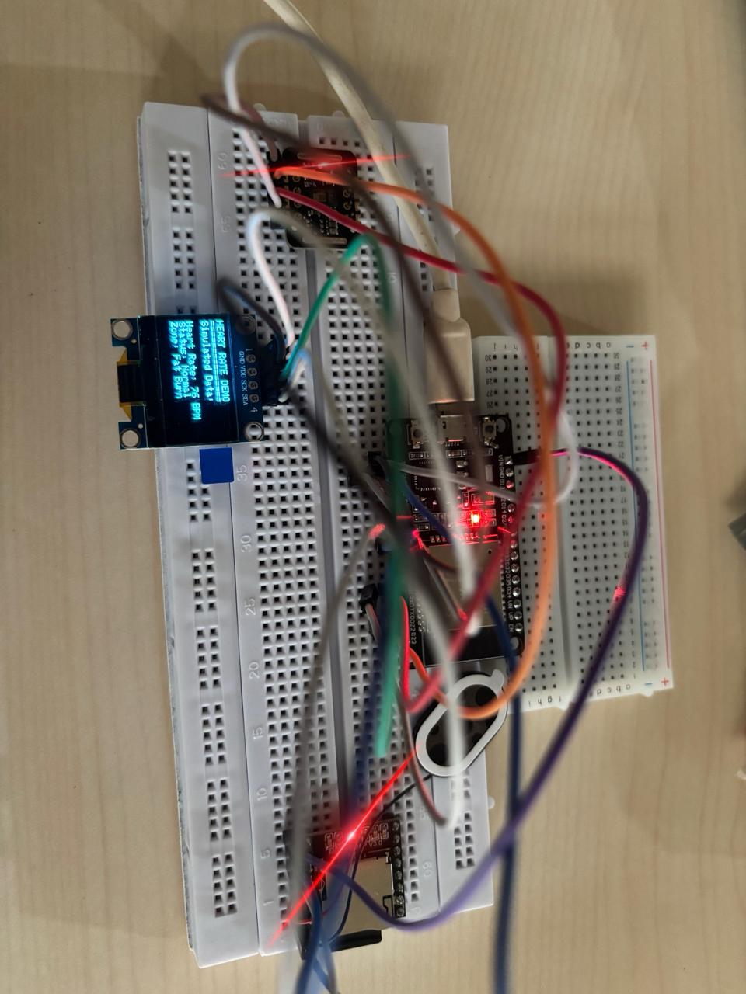
100 % Implementation with Live Demo

Slide 8
Final Report Status:
Completed all sections as per format.

Slide 9
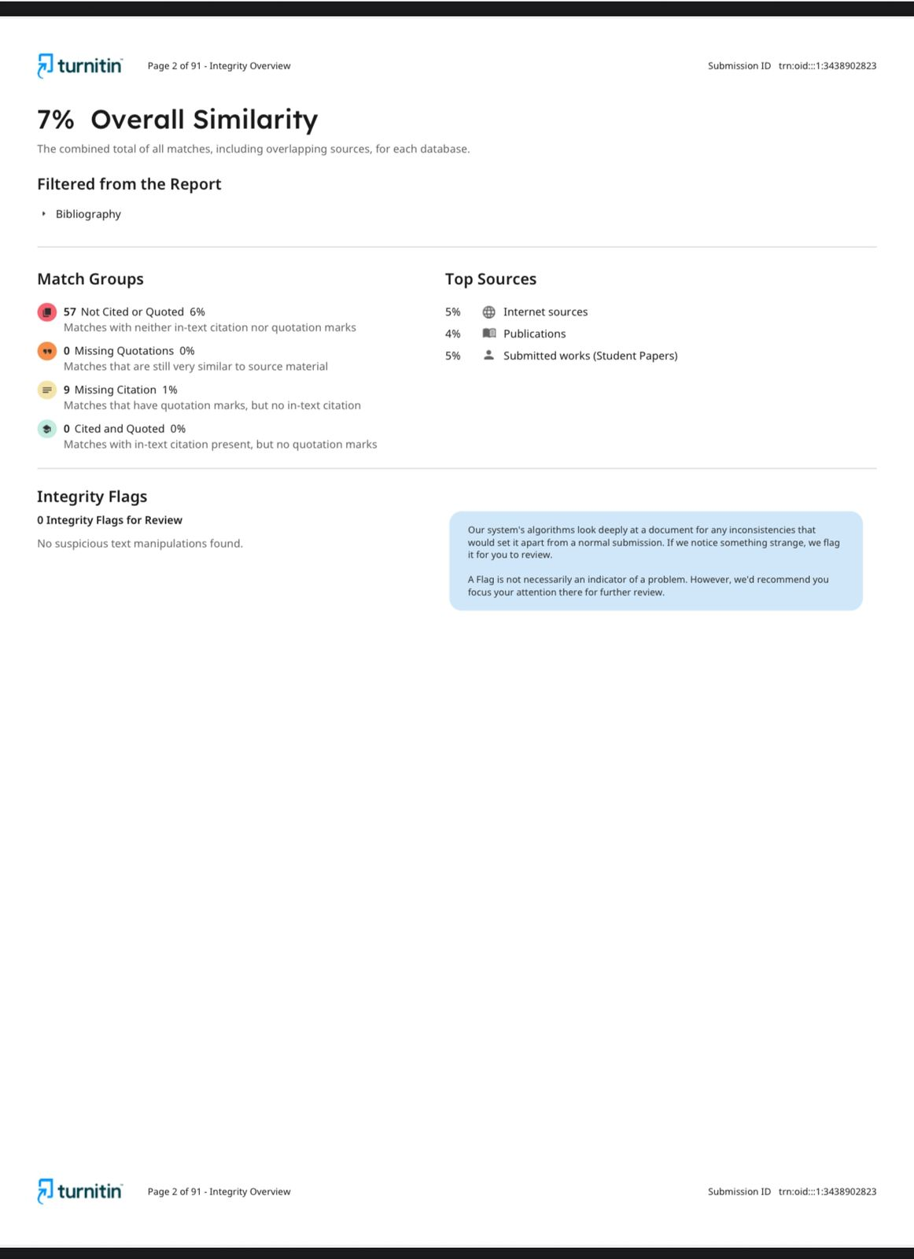
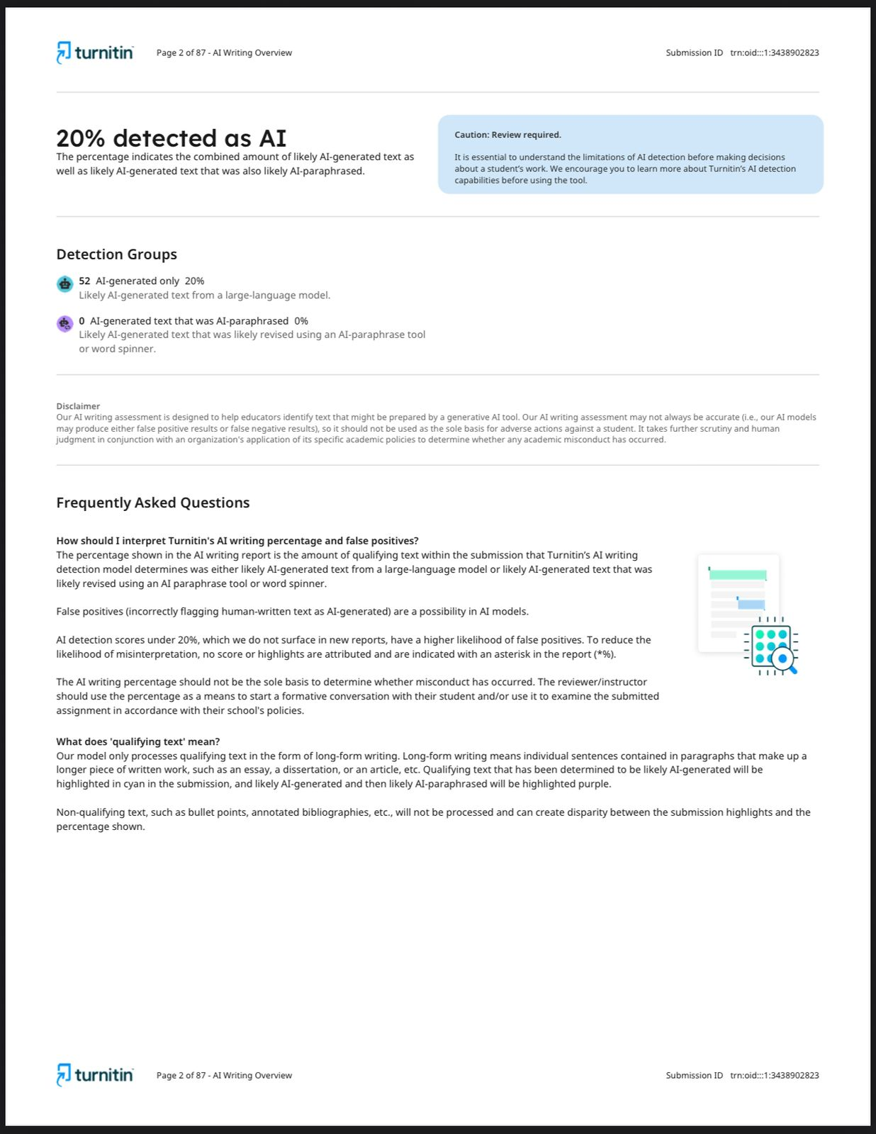
Plagiarism Report:

Slide 10
Research Paper
Completed the research paper as per IEEE format.

Slide 11
SDG Mapping with Problem Statement
SDG 3 – Good Health & Well-Being: Promotes regular exercise at the right intensity to improve health outcomes and prevent chronic diseases using an accessible, low-effort fitness system.
SDG 9 – Industry, Innovation & Infrastructure: Showcases affordable innovation by using low-cost embedded systems and sensors to make health-tech solutions more accessible in resource-limited regions.
SDG 12 – Responsible Consumption & Production: Follows a minimalistic, energy-efficient design that avoids constant charging or internet dependence, reducing electronic waste and supporting sustainable use.

Slide 12
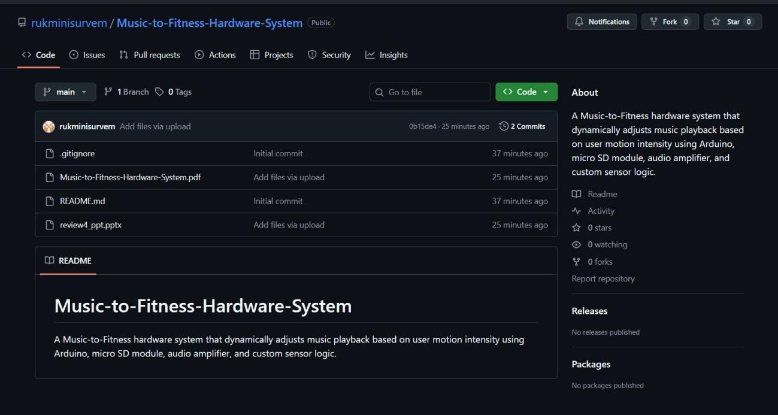
Github Link
https://github.com/rukminisurvem/Music-to-Fitness-Hardware-System

Slide 13
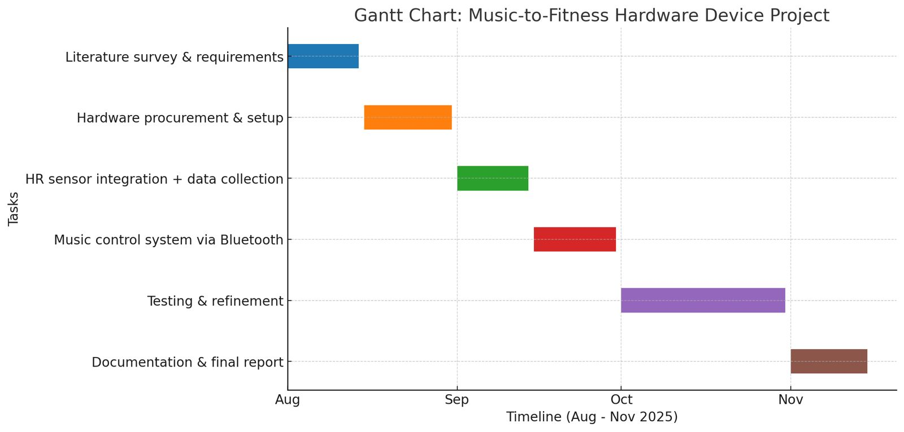
Timeline of the Project (Gantt Chart)

Slide 14
References (IEEE Paper format)
• H. Liu, J. Hu, and M. Rauterberg, “Music Playlist Recommendation Based on User Heartbeat and Music Preference,” IEEE Transactions, 2009.
• ISO/IEEE 11073, “Personal Health Device Communication Standards.”

Slide 15
References:
• Espressif Systems, “ESP32 Technical Reference Manual,” 2024.
• Maxim Integrated, “MAX30100 Pulse Oximeter and Heart-Rate Sensor Datasheet,” 2024.
• A. F. Barbosa et al., “Heart Rate Based Real-Time Music Adaptation,” IEEE Access, May 2022 (online repository, no volume/page).
• IEEE Standard 11073 for Health Informatics, 2023 (repository document, no volume/page).
• Additional IEEE/Scopus papers from the project literature survey.

Slide 16


